Slide 1
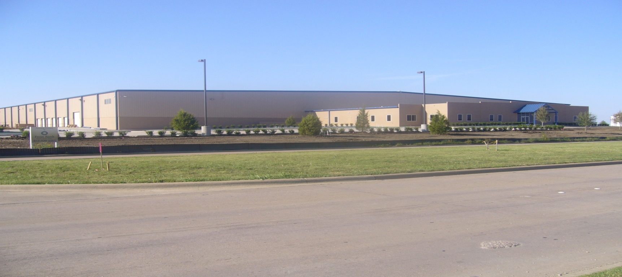
Universal Air Conditioner, Inc. 26 Years of Excellence
1441 Heritage Parkway
Mansfield, TX 76063
817-740-3900
800-648-8648
uacsales@uacparts.com
www.uacparts.com
Since 1988

Slide 2
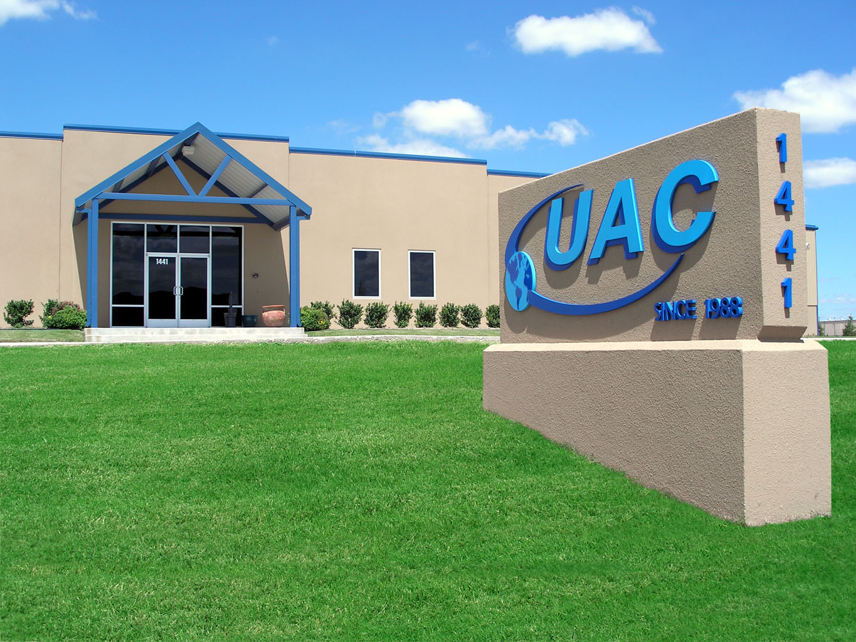

Slide 4
Our Mission:
Provide Quality Automotive, Truck
and Off Road Heavy Duty
Air Conditioning Replacement Parts
at Reasonable Prices

Slide 5
Our Footprint:
Canada
North America
Europe
Asia
Central America
Africa
South America
Australia

Slide 6
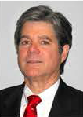
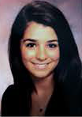
Our History:
In 1980, Luis Coll (Univ. of Pennsylvania, 1952), an oral surgeon and father of three, chose to pursue his passion as a mechanic and engineer. He created a company in Puerto Rico that manufactured A/C parts, ultimately exporting them. In 1987, Luis created UAC to supply the manufacturing facility. When Luis passed away in 1990, his son Carlos, expecting the birth of his second child, Sophia, chose to leave his profession as a lawyer to run the family business.
In 1990, Carlos began importing from Asia, allowing the company to grow as a distributor with a manufacturing background, known for its high quality and low cost. In 1991, Carlos became the industry’s first to collaborate with Chinese factories, becoming dominant in product development, later earning the MACS Industry Pioneer Award. In 2006, after years of re-engineering and providing high quality products, Carlos consolidated three warehouses into one, further improving logistics and service.
Presently, Carlos’ daughter, Sophia, after completing her B.S. in Economics from the Univ. of Pennsylvania, is next in line to run the family business.
As Vice President, she has partnered with her father to improve product development and customer service through advances in the company’s IT department.

Slide 8
Universal Air Conditioner, Inc.
UAC MANAGEMENT TEAM
Carlos Coll | President | Carlos.coll@uacparts.com
Sophia Coll | Vice President | Sophia.coll@uacparts.com
Cherie Ellis | Financial Manager | Cherie.ellis@uacparts.com
Theresa Devine | Sales Manager | Theresa.devine@uacparts.com
James Trachier | IT Manager | James.trachier@uacparts.com
Angela Anway | Purchasing/Product Development Manager | Angela.anway@uacparts.com
April Flores | Human Resources Manager | April.flores@uacparts.com
Isaias Chapa | Warehouse Manager | Isaias.chapa@uacparts.com

Slide 9
Universal Air Conditioner, Inc.
UAC SALESTEAM
Steve Reynolds | Sales Associate | Steve.reynolds@uacparts.com
Laura Bocanegra | Sales Associate | Laura.bocanegra@uacparts.com
David Uptmore | Sales Associate | David.uptmore@uacparts.com
Luke Masters | Sales Associate | Luke.masters@uacparts.com
Jonathan Silva | Sales Associate | Jonathan.silva@uacparts.com
James Smith | Sales Associate | James.smith@uacparts.com
Tasha Germany | Customer Service Representative | Tasha.germany@uacparts.com
Shelley Barnes | Customer Service Representative | Shelley.barnes@uacparts.com

Slide 10
Universal Air Conditioner, Inc.
UAC SUPPORT TEAM
Cecilia Garcia | Accounts Payable | Cecelia.Garcia@uacparts.com
Sheila Maulden | Accounts Payable | Sheila.maulden@uacparts.com
Diana Childress | Accounts Receivable | Diana.childress@uacparts.com
Cecilia Chavez | Accounts Receivable | Cecilia.chavez@uacparts.com
Mayra Sosa | Accounts Receivable | Mayra.sosa@uacparts.com
Ashley Burgess | Product Development/Purchasing | Ashley.burgess@uacparts.com
Raiza Floriano | Product Development/Purchasing | Raiza.floriano@uacparts.com
Donna Parker | Import Purchasing/Inbound Logistics | Donna.parker@uacparts.com
Maria Alvarado | Returns Department | Maria.alvarado@uacparts.com
Alma Cano | Returns Department | Alma.cano@uacparts.com
Ron Savilonis | Production/RGA | Ron.savilonis@uacparts.com
Pascual Ramirez | Production/RGA | Pascual.ramirez@uacparts.com
James Campbell | Validation Supervisor | James.campbell@uacparts.com
Adolfo Perez | Validation Team | Adolfo.perez@uacparts.com
Juan Ramirez | Validation Team | Juan.ramirez@uacparts.com
Eva Beltran | Outbound Logistics Coordinator | Eva.beltran@uacparts.com
Nydia Martinez | Outbound Logistics Assistant | Nydia.martinez@uacparts.com
Irma Garcia | Warehouse Receiving Supervisor | Irma.garcia@uacparts.com
Juan Lopez | Warehouse Logistics Supervisor | Juan.lopez@uacparts.com

Slide 11
UAC’s Partnerships
UAC has a better way of doing business.
In today’s world market, UAC is different. While most simply outsource their parts, UAC has a long standing partnership with its factories to supply the highest quality products world-wide. Our plants are QS and ISO 9000 approved providing quality products.
Our factories are standing by to assure all parts manufactured for UAC are the “perfect fit” at an “affordable price”

Slide 12
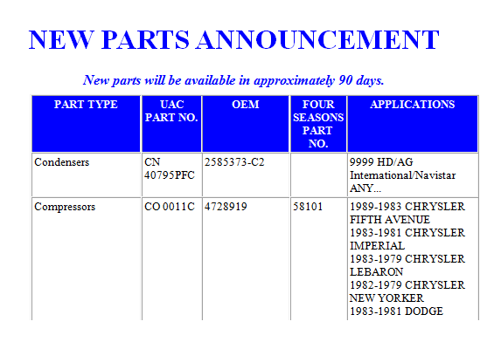
Our Product Development
UAC has more than 20 years experience in importing products and parts
We carefully select parts for development based on:
National database research
Special customer requests
Market demand
Industry trends
We pride ourselves on being first to market on product development, and announce 10-15 new products per week!
Weekly email to our customers to announce new products coming soon!
Notes:
12

Slide 13
Our Validation/Quality Control Process
UAC has a team of highly skilled and trained technicians that:
Validate every part we develop
Assist with customer technical calls
Conduct continuous quality control to make sure we have consistent manufacturing
UAC maintains an extensive “library” of parts that contains all samples used for development
UAC only approves factories that manufacture the highest quality parts, many of UAC’s factories produce for the OEM/OES market
All vendors are required to submit a physical sample to be validated which must be approved before UAC will order the part. Once the part is approved and ordered it will go through more rounds of quality checks when it arrives to ensure it is being built at high quality standards
UAC has a simple process to resolve customer complaints for non-conformance or fit complaints to make sure they are resolved swiftly
Notes:
13

Slide 14
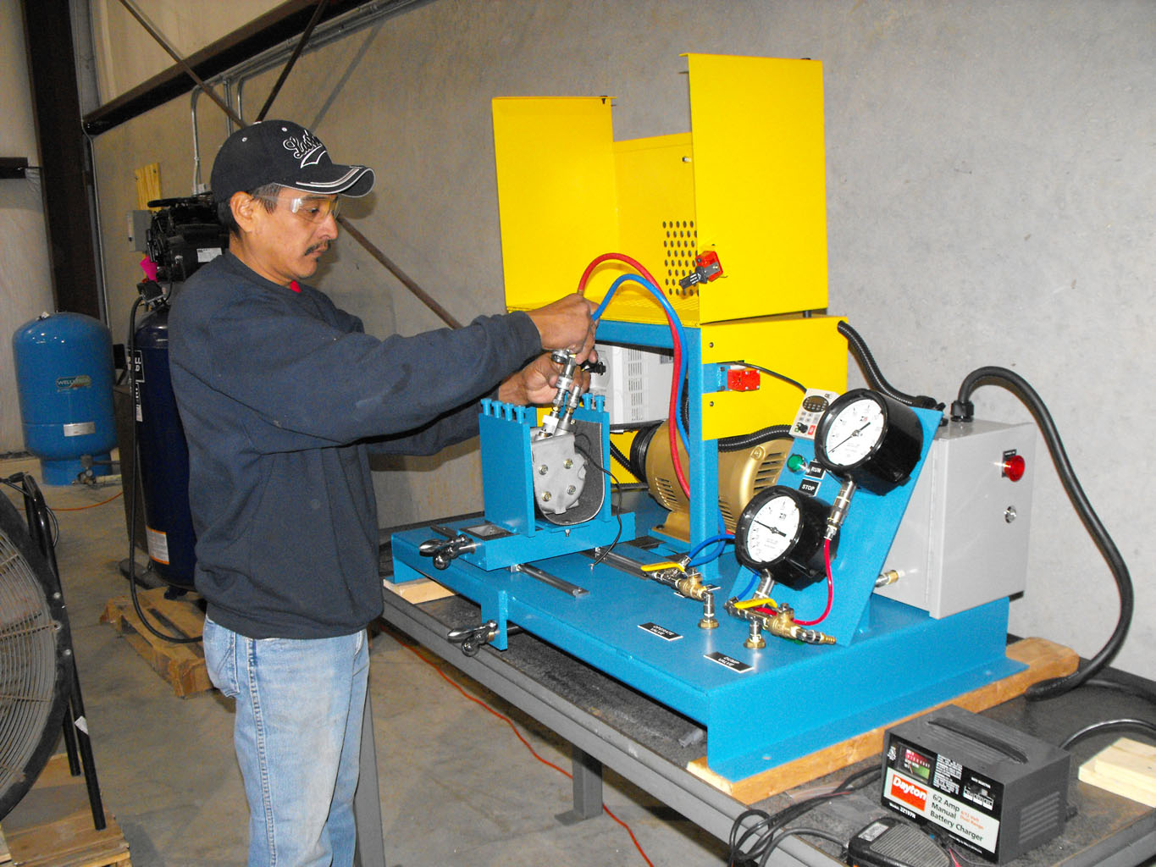
Validation Team

Slide 15
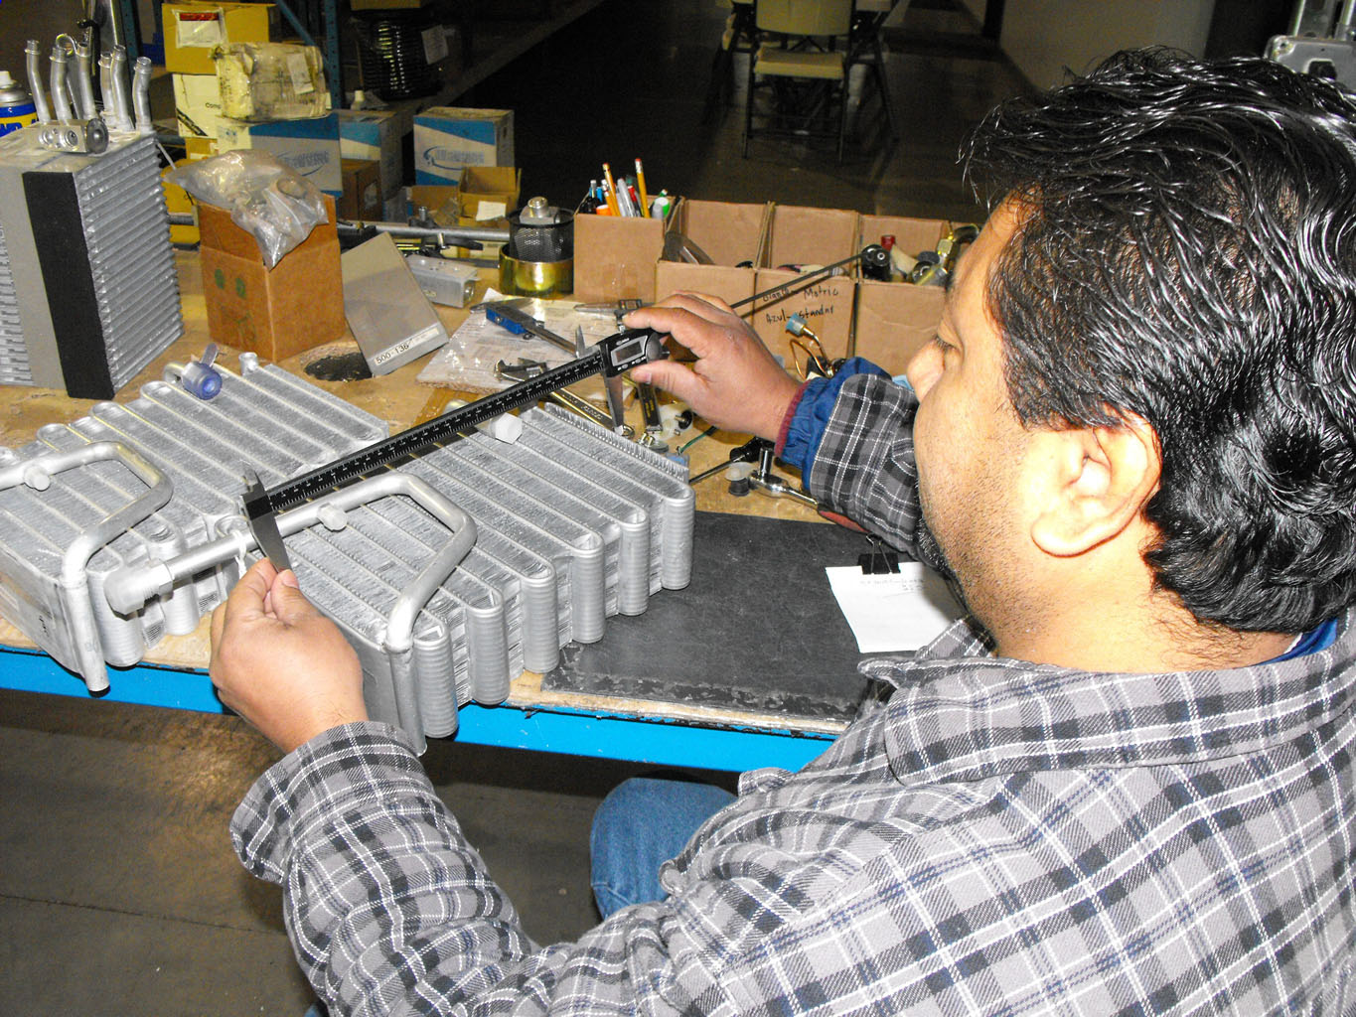
Validation Team

Slide 16
Universal Air Conditioner, Inc.
Up to date Online Catalog www.uacparts.com
Electronic Cataloging available to Wrenchead and Activant Customers
EDI Transmission capabilities
Interchanges to Your Current Supplier
Standard UAC Packaging
UPC Bar Code with UAC Number

Slide 17
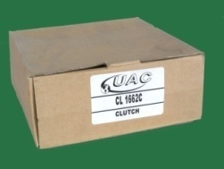
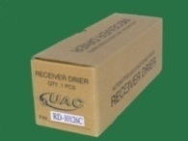
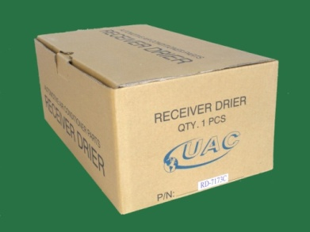
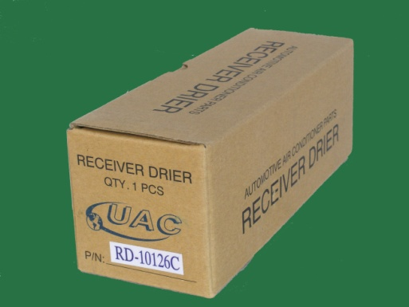
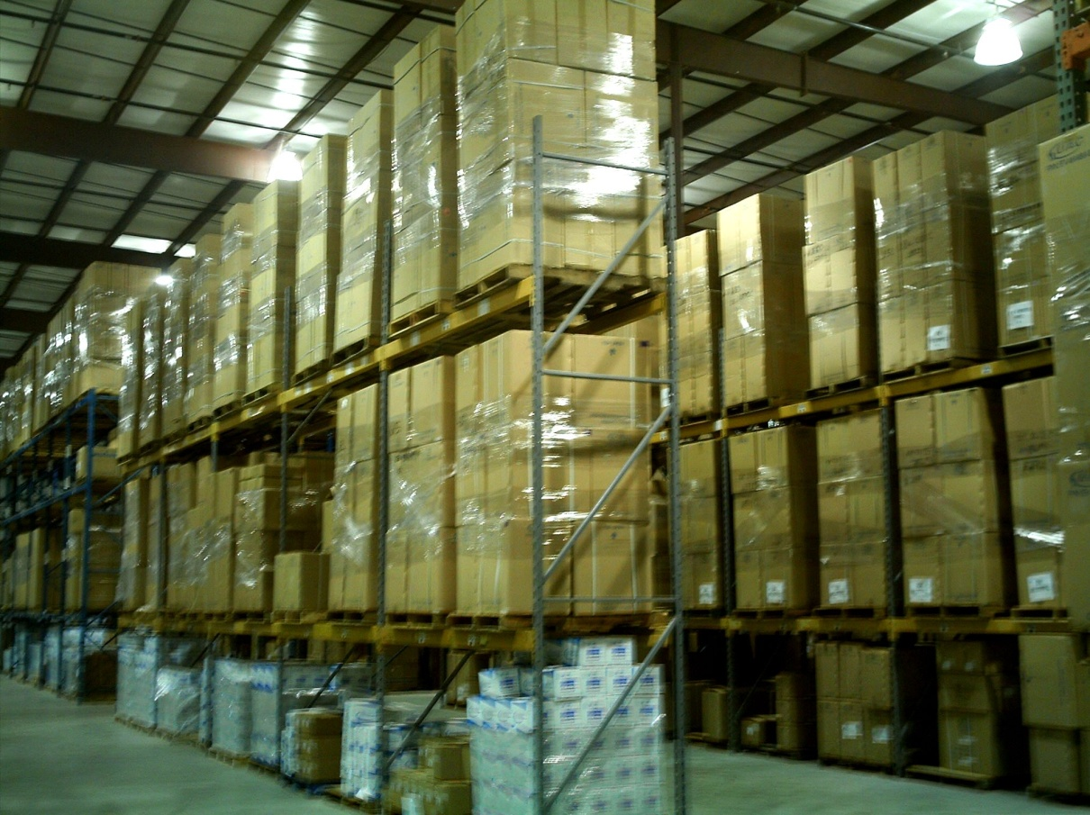
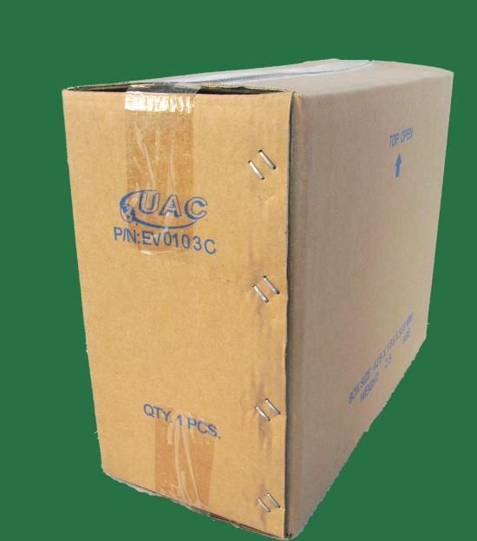
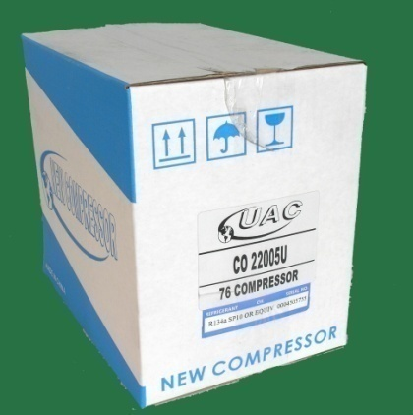
Our Packaging
Products and packaging you can trust
While our competition will often use their boxes to re-box products with inferior brands, UAC brand product is only found in our signature boxes. All brand products approved and distributed by UAC will remain in the original package. This is the only way to insure quality and maintain product integrity.
Notes:
17

Slide 18
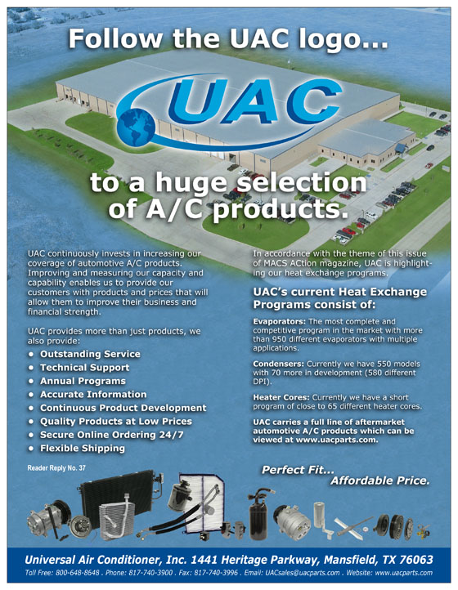
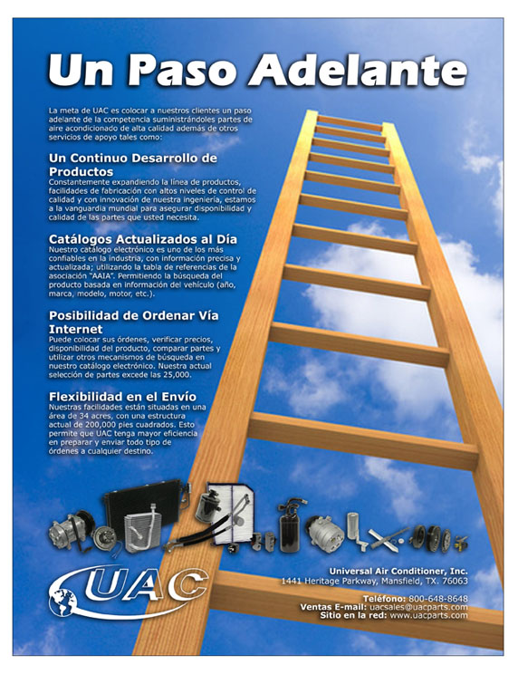
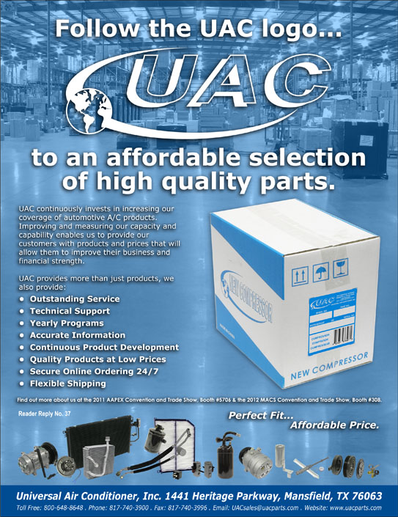
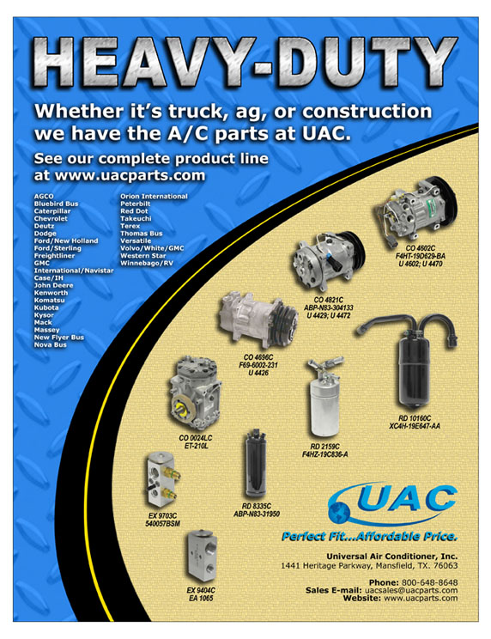
Marketing Materials

Slide 19
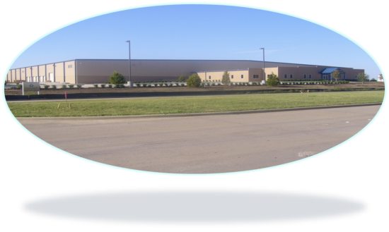
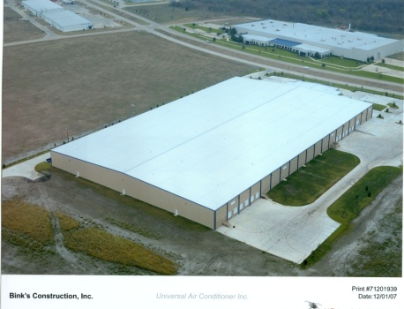
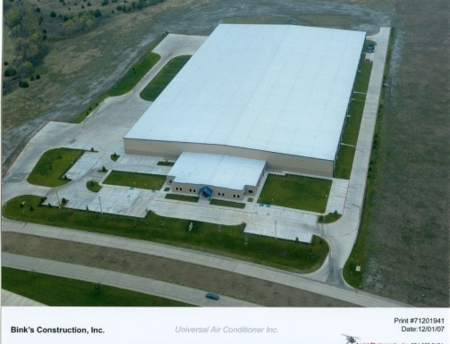
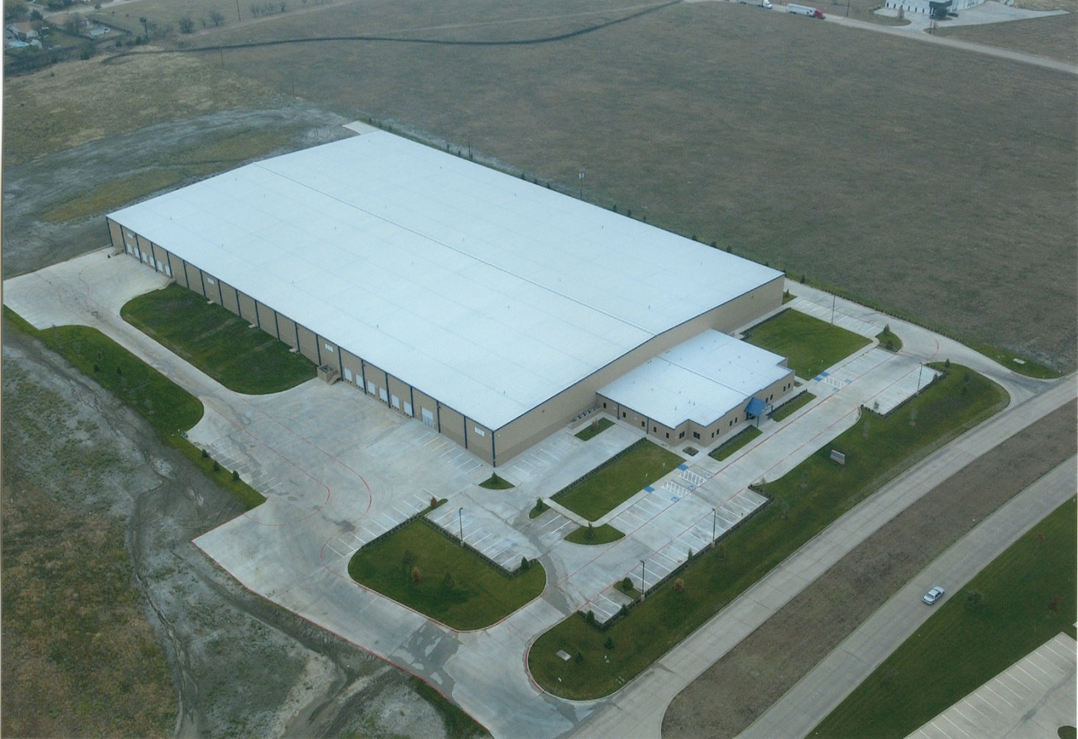
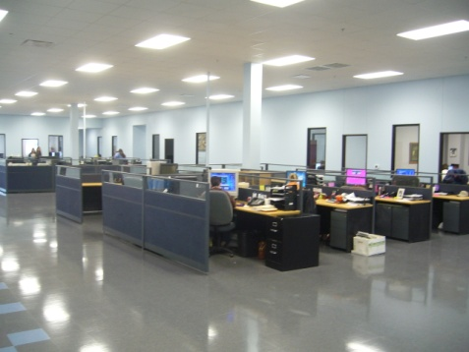
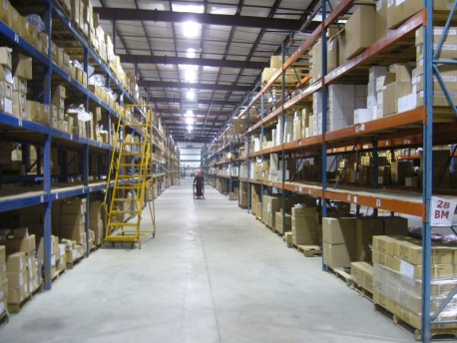
Our Facility
Our state of the art headquarters and distribution center.
Situated on 17 acres, our new 200,000sq/ft
state-of-the-art facility has plenty of room for future expansion. Centrally located in Texas between Dallas and Fort Worth, it is the perfect place for shipping across North or South America and the World.
1441 Heritage Parkway
Mansfield, TX 76063
Notes:
19

Slide 20
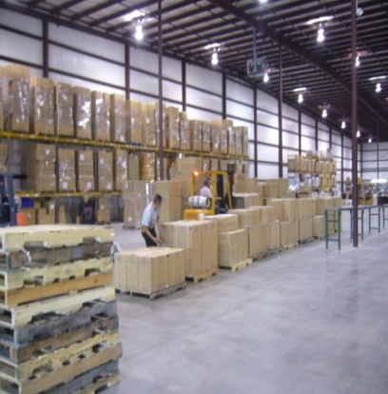
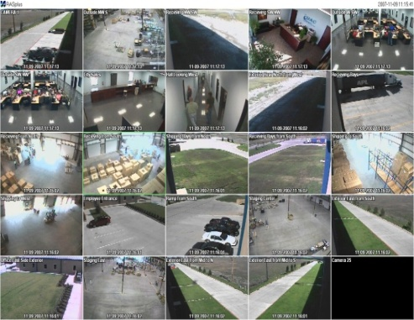
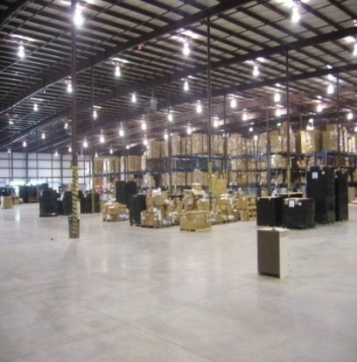
Our Warehouse
188,000 square foot warehouse
Our state of the art warehouse spans
3 ½ football fields. All operations are constantly monitored to assure maximum throughput and efficient flow.
This provides us a distinct advantage over all our competition.
1441 Heritage Parkway
Mansfield, TX 76063
Notes:
20

Slide 21
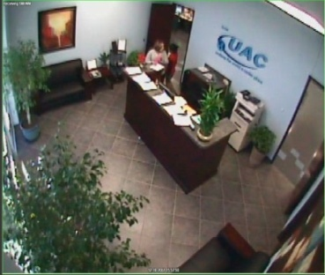
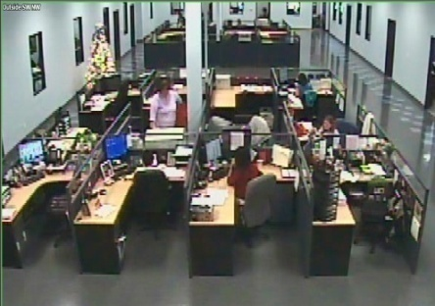
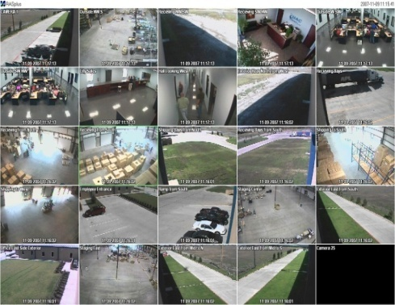
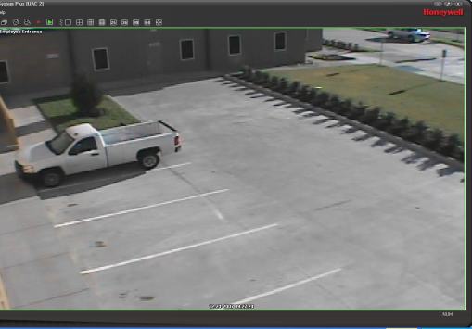
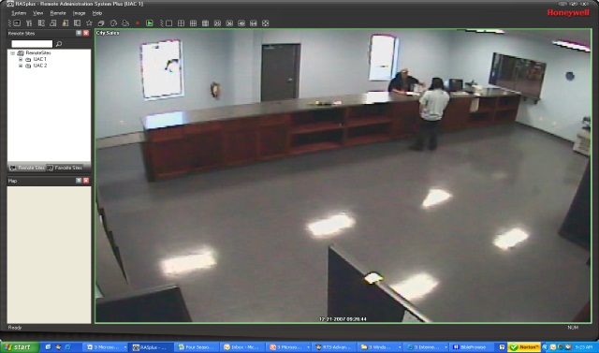
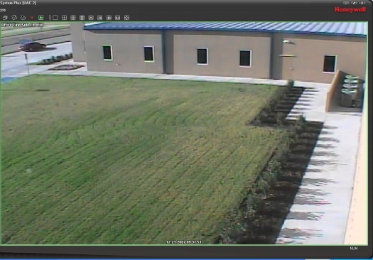
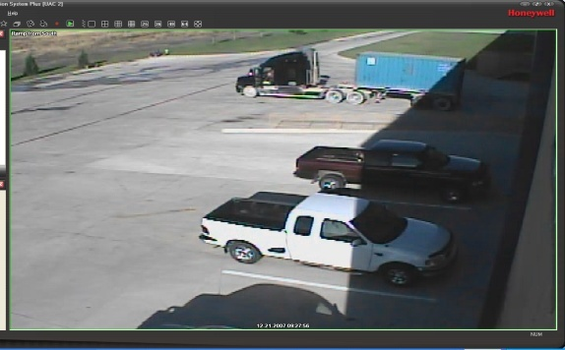
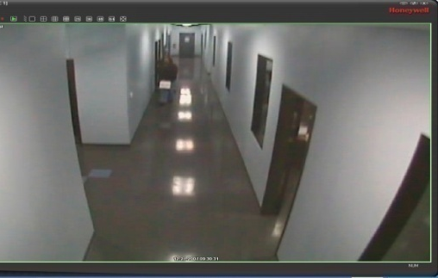
Our Corporate Office
12,000 square foot corporate office
Our corporate office utilizes the open concept to run operations with optimum efficiency. This high-tech information center provides accurate up-to-the-minute answers for our customers. All the knowledge you need
from one central source is one more advantage we have over our competition.
1441 Heritage Parkway
Mansfield, TX 76063
Notes:
21

Slide 22
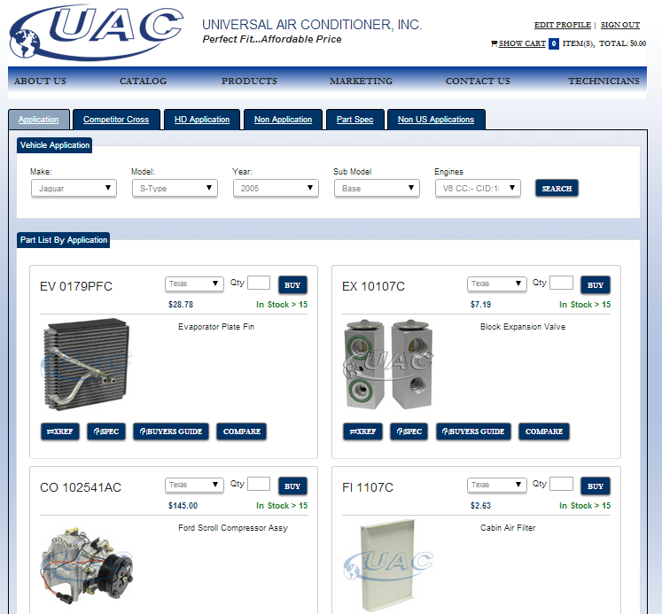
Our Online Catalog
Up-to-the-minute, accurate information, anywhere, anytime
UAC has one of the most comprehensive electronic AC catalogs, which has always been ahead of the competition. Our web site provides online ordering, AAIA applications, and accurate up-to-date information in a user friendly interface. Our catalog is one of the
most trusted catalogs
in the industry today.
SEARCH BY APPLICATION
VIEW PRICING
ADD TO CART
CHECK
AVAILABILITY
Notes:
22

Slide 23
Our Products
Over 15,000 SKU’s in our extensive A/C parts program.
Our compressor facilities output more than 10 million units annually.
Our certified compressor factories have all required ISO certificates and are OEM/OES qualified suppliers.
UAC products include:
Compressors
Hose Assemblies
Condensers
Evaporators
Driers
Accumulators
Expansion Valves
and much more!

Slide 24
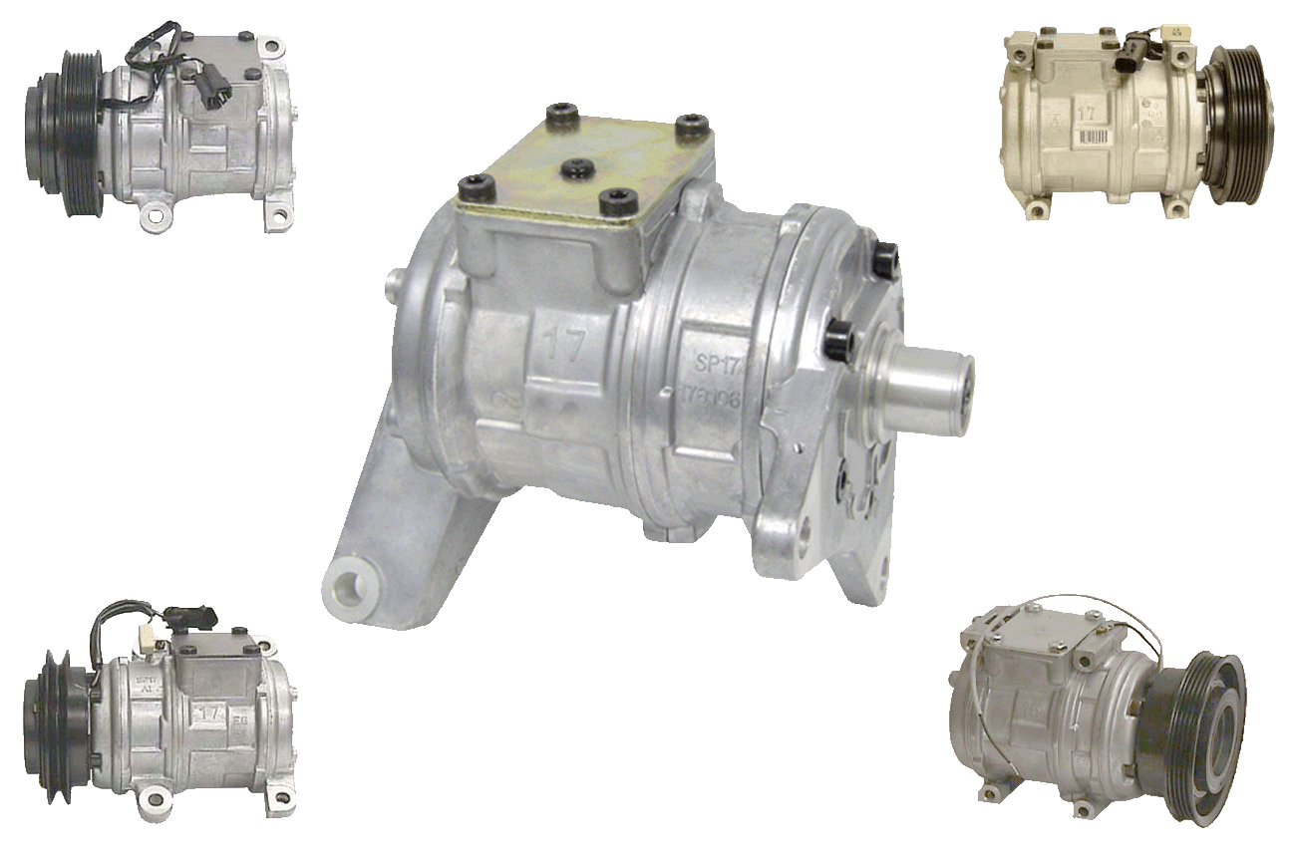
New Replacement 10PA
New Compressors:

Slide 25
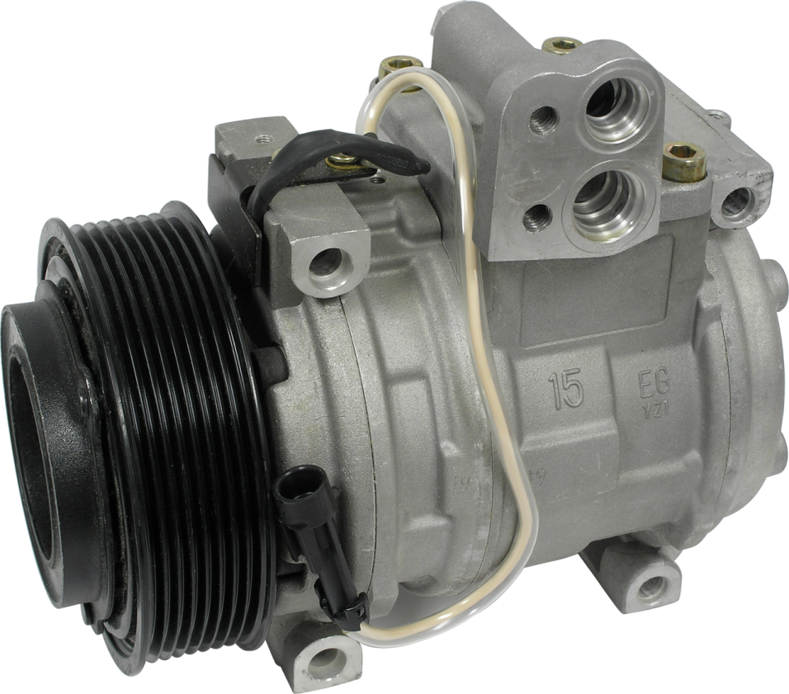
New Compressors:
Off Road and Heavy Duty:

Slide 26
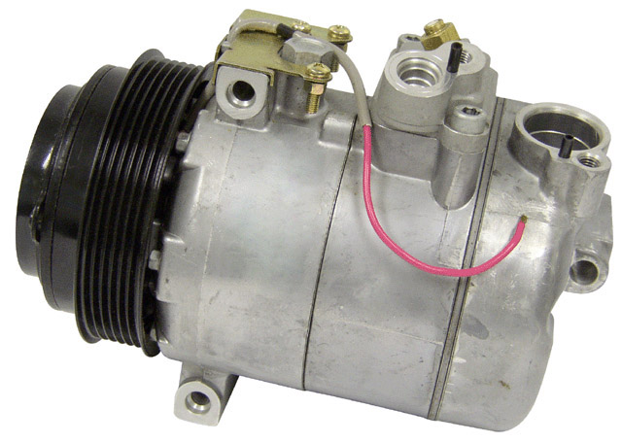
New Compressors:
New 7SB16C Replacement Compressors with Clutch for Imports Audi / Volkswagen Mercedes, BMW, Saab and Opel

Slide 27
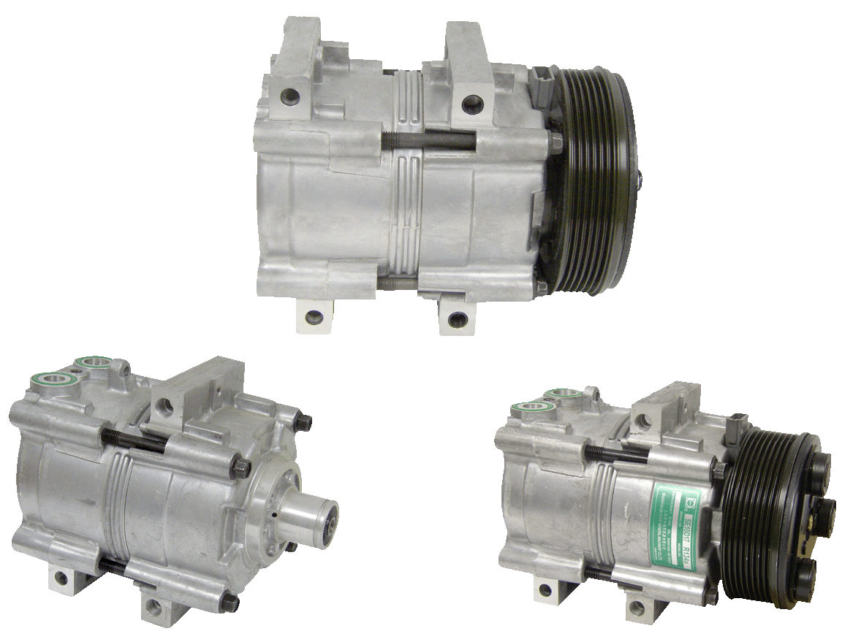
New Replacement FS10 Compressors
New Compressors:

Slide 28
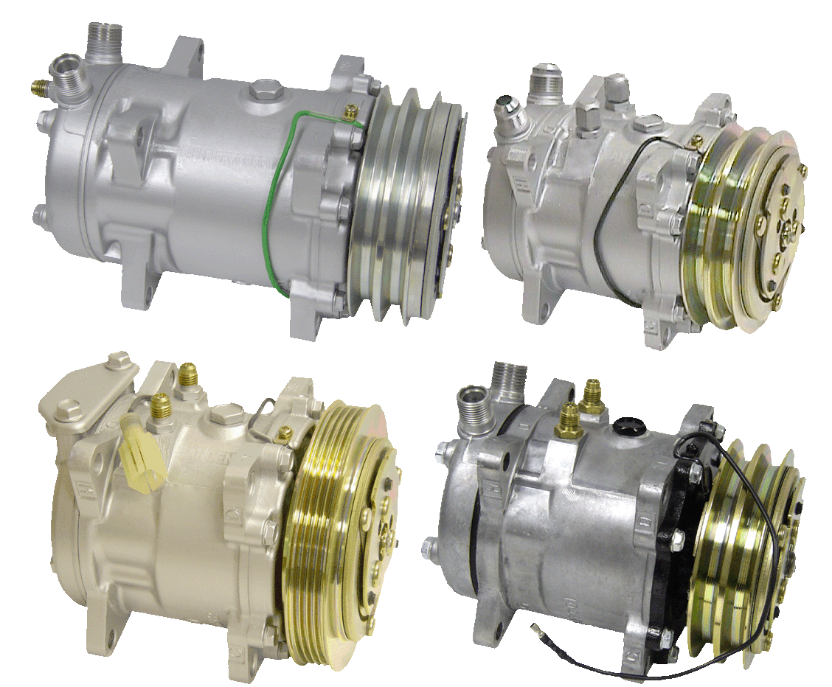
New Replacement Sanden Compressors
New Compressors:

Slide 29
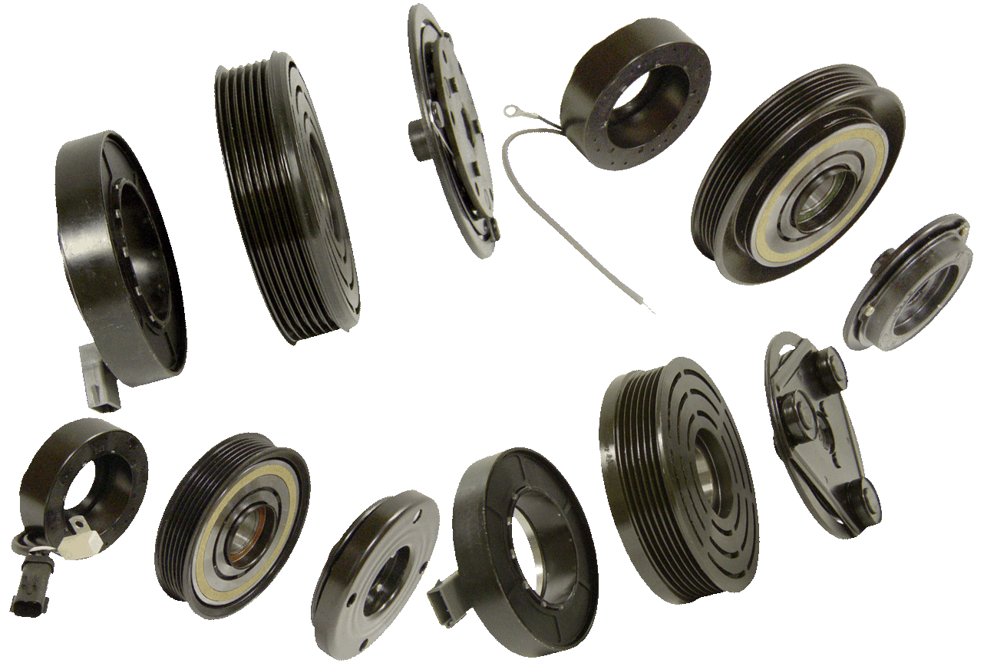
New Clutch Assemblies:

Slide 30
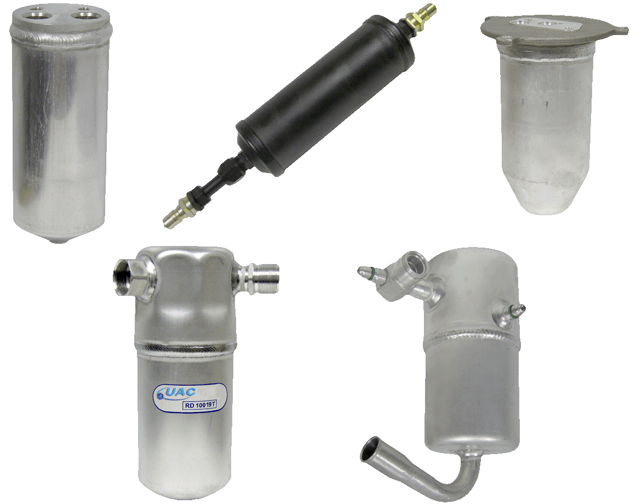
New Receiver Driers:

Slide 31
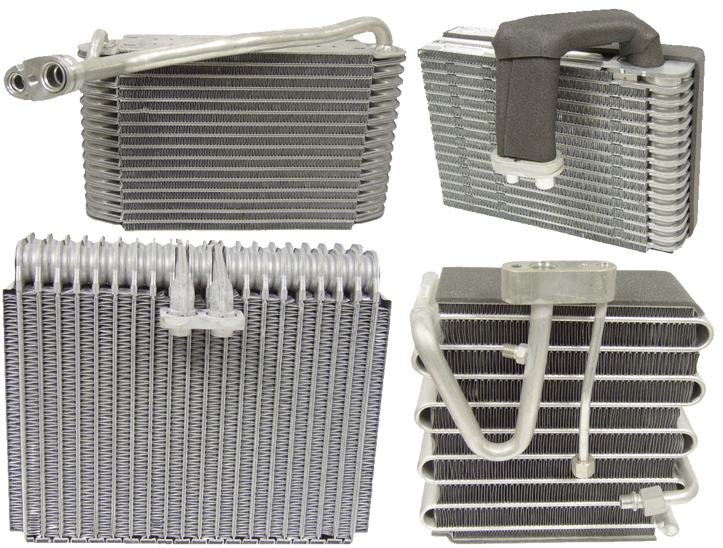
New Evaporator Cores:

Slide 32
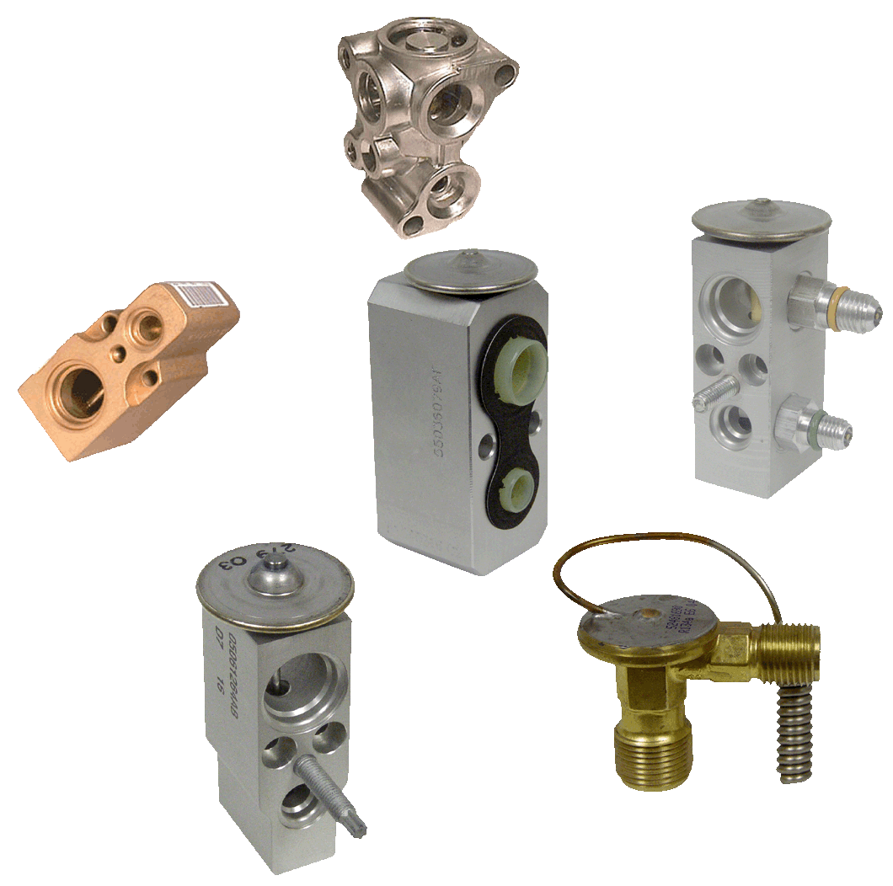
New Expansion Valves:

Slide 33
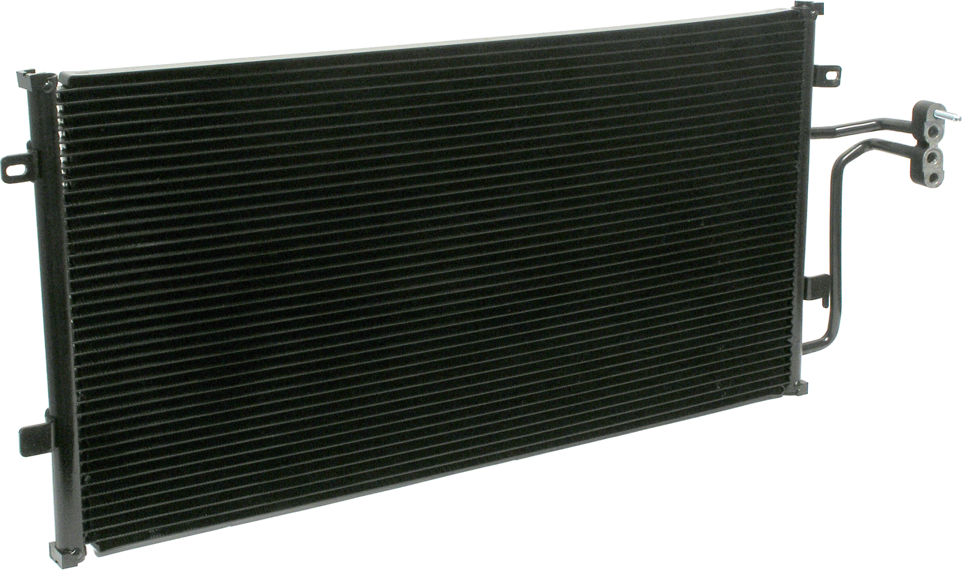
New Condensers:

Slide 34
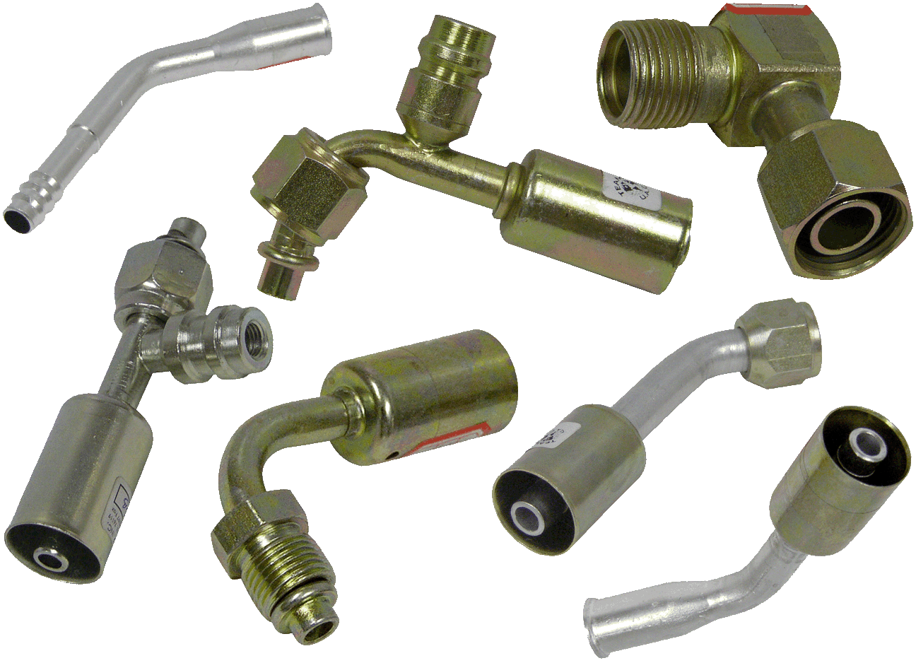
New Fittings and Adaptors:

Slide 35
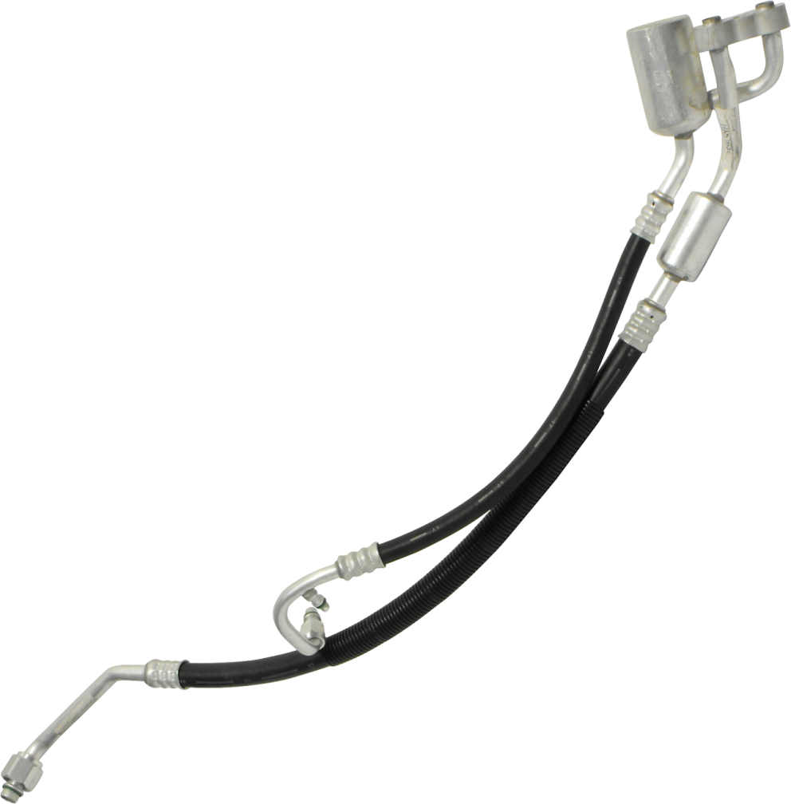
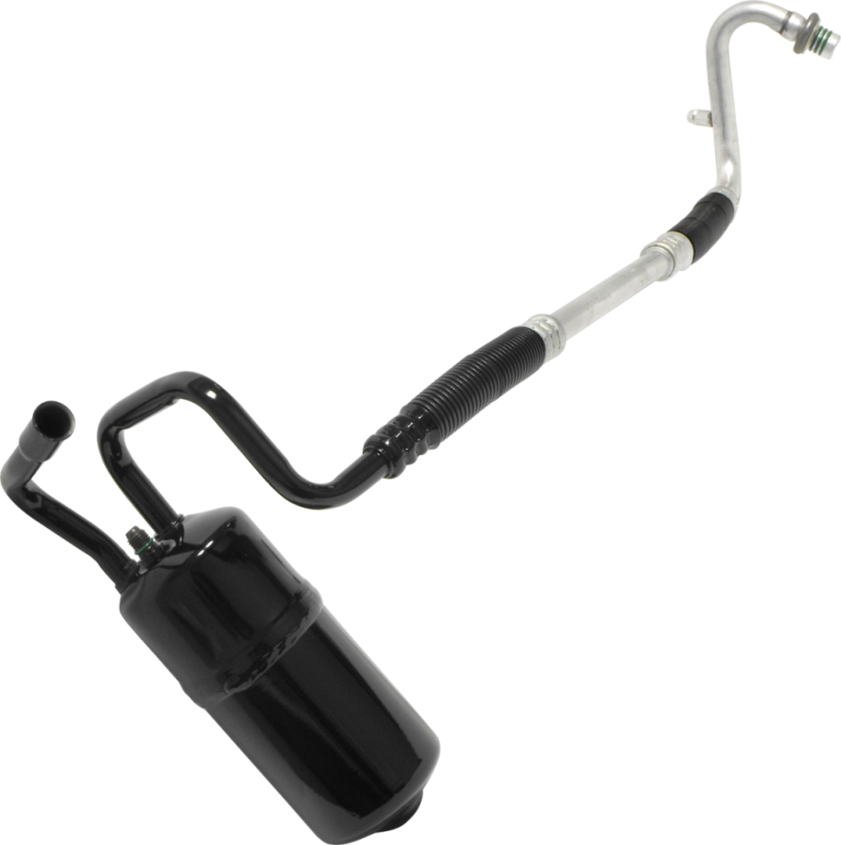
New Hose Assemblies:
UAC is rapidly
expanding it’s
hose program.
50+ currently in development in May, 2014
1,300+ SKU’s in stock

Slide 36
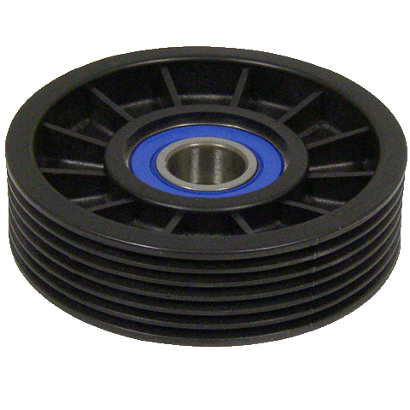
New Idler Pulleys and Eccentrics:
Plastic
Steel
Standard & Adjustable Pulleys
Back Idler Pulleys
Parts and Eccentrics

Slide 37
Service and Other Products:
Clutch Bearings
Motors, Blower and Radiator Fan
O-Rings & Gaskets Including Kits
Relays
Switches
Service Items and Tools

Slide 38
Our Extensive Inventory
Fill rates over 95%
6,000+ SKU’s in stock year-round
2 Express Warehouses to address the “proximity factor”
Miami
5551 NW 72th Avenue, Miami, Florida 33166
305-882-1313
Los Angeles
13255 Woodruff Avenue, Downey, California 90242
562-803-5611

Slide 45
Our Shipping Services
UPS
FedEx
Lonestar (LSO)
OnTrac
LTL Carriers

Slide 48
Universal Air Conditioner, Inc. 26 Years of Excellence
1441 Heritage Parkway
Mansfield, TX 76063
817-740-3900
800-648-8648
uacsales@uacparts.com
www.uacparts.com
Since 1988

